Slide 1

STUDENT MANAGEMENT SYSTEM
PROJECT MENTOR- Mrs. Priya Agarwal

Slide 2
INTRODUCTION
The student management system(SMS) is able to handle all the details about the student including course, subject, attendance, session etc.
This system is an automated version of the regular school management system.

Slide 3
OBJECTIVES
The SMS system is a management information system for managing student data.
To provide capabilities for registering student in courses, Admitting students, tracking student attendance &
To ensure data integrity, privacy, and security in an open access environment.

Slide 4
PROJECT CATEGORY
IT comes under web based application.
This application can be accessed anytime, anywhere via the pc with an internet connection.
It needs lower requirements on the end user system and simplified architecture.

Slide 5
Tools
We have used php, CSS, JavaScript as scripting language.
We have MySQL database for storing the database of students details.
This website executes on XAMPP/WAMPP server.
The website can be operated on any web browser..

Slide 6
HARDWARE AND SOFTWARE REQUIRMENTS
Recent versions of Google Chrome, Firefox, Internet Explorer, or safari.
Hardware Requirements:
CPU: Single core 2.4 GHZ
RAM: 512 MB
GRAPHICS CARD: Intel or Nvidia
HARD DRIVE: 5 Gigabytes
NETWORK: Broadband recommended
Processor: Pentium
Operating System: Window(XP, Vista, 7 ,8 ,9, 10), Vista, Mac OS, Linux, Unix.
Internet connection with good speed.

Slide 7
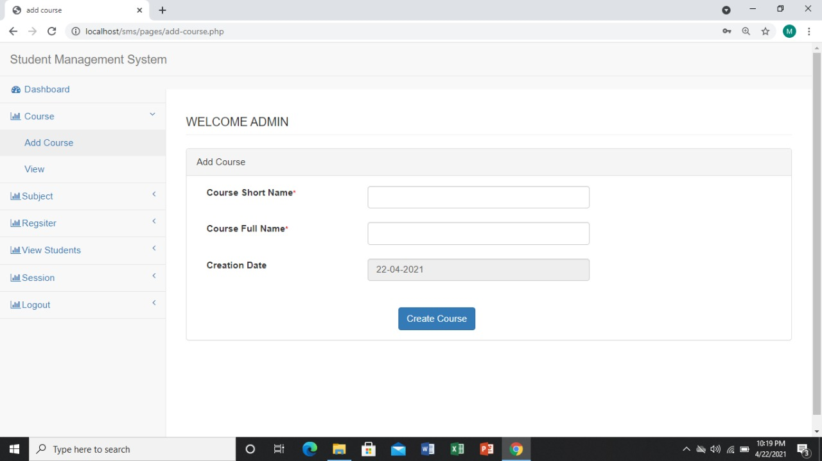
SCREENSHOT

Slide 8
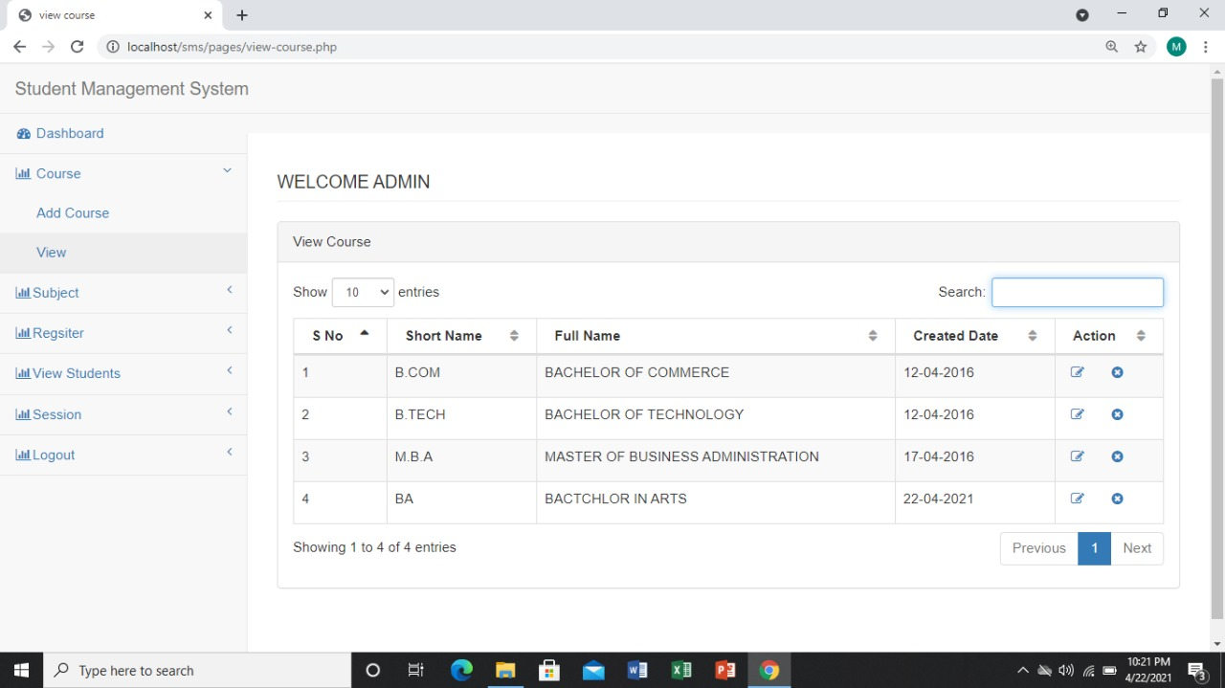

Slide 9
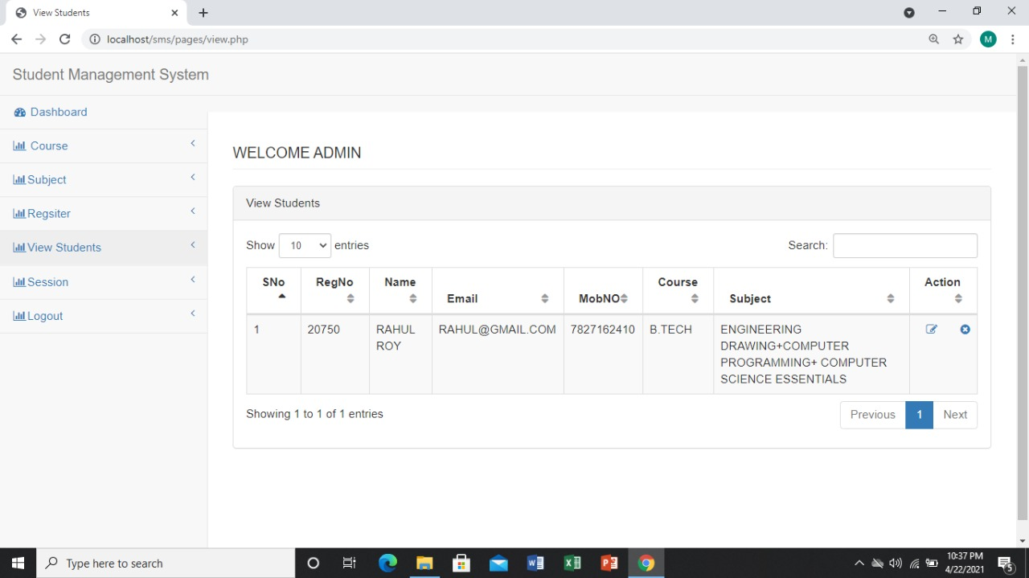

Slide 10
Modules
Dashboard
Course
-> Add Course
-> View
Subject
-> Add subject
-> View subject
View Students
Logout

Slide 11
FUTURE SCOPE OF THE PROJECT
In future it can be used to upload or download notes of the student.
The system can be more interactive.
An application can be further developed for android platform and can be operated on an operating system.

Slide 12
Thankyou

